Slide 1
機器學習於材料資訊的應用 期中報告
組長 : 陳邦仁
組員 : 洪承彬、張皓凱

Slide 2
Outline
Data preparation
Model construction
Model variables
Result
Outside of the training set

Slide 3
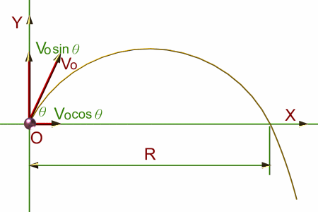
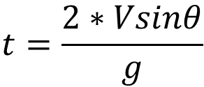
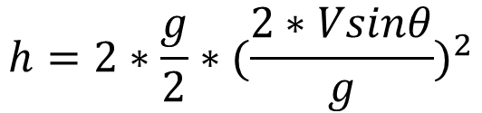
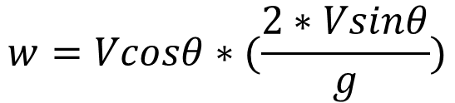
Data Preparation
$$t=\frac{2∗Vsinθ}{g}$$
$$w=Vcosθ∗(\frac{2∗Vsinθ}{g})$$
$$h=2∗\frac{g}{2}∗{(\frac{2∗Vsinθ}{g})}^{2}$$

Slide 4
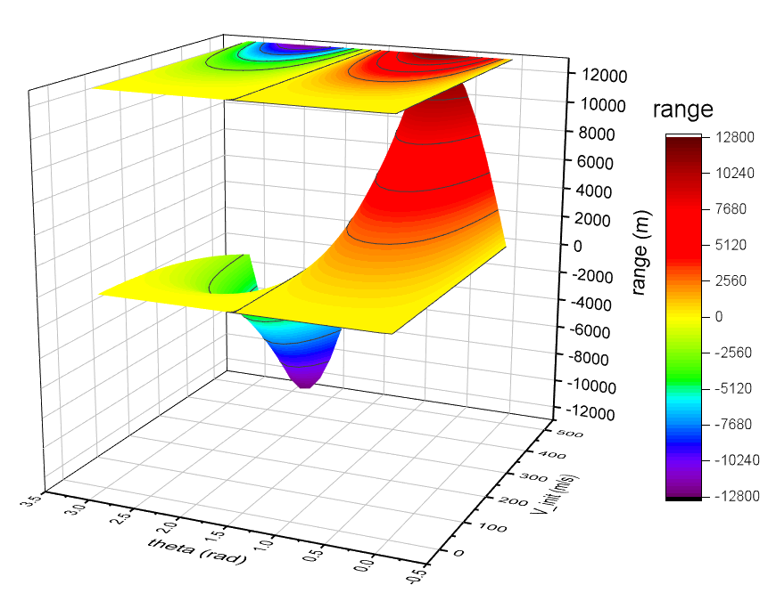
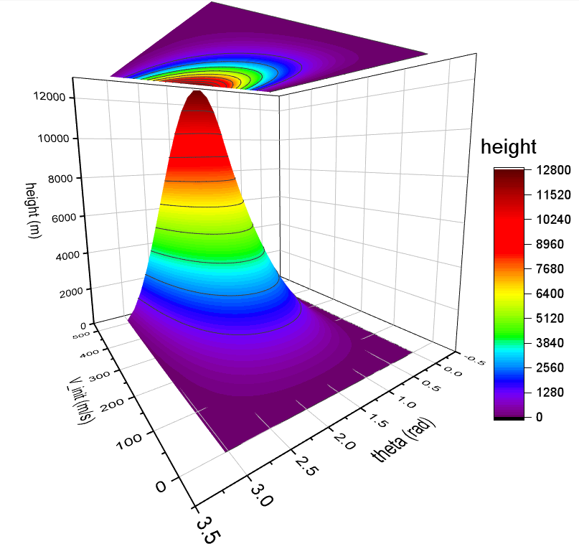
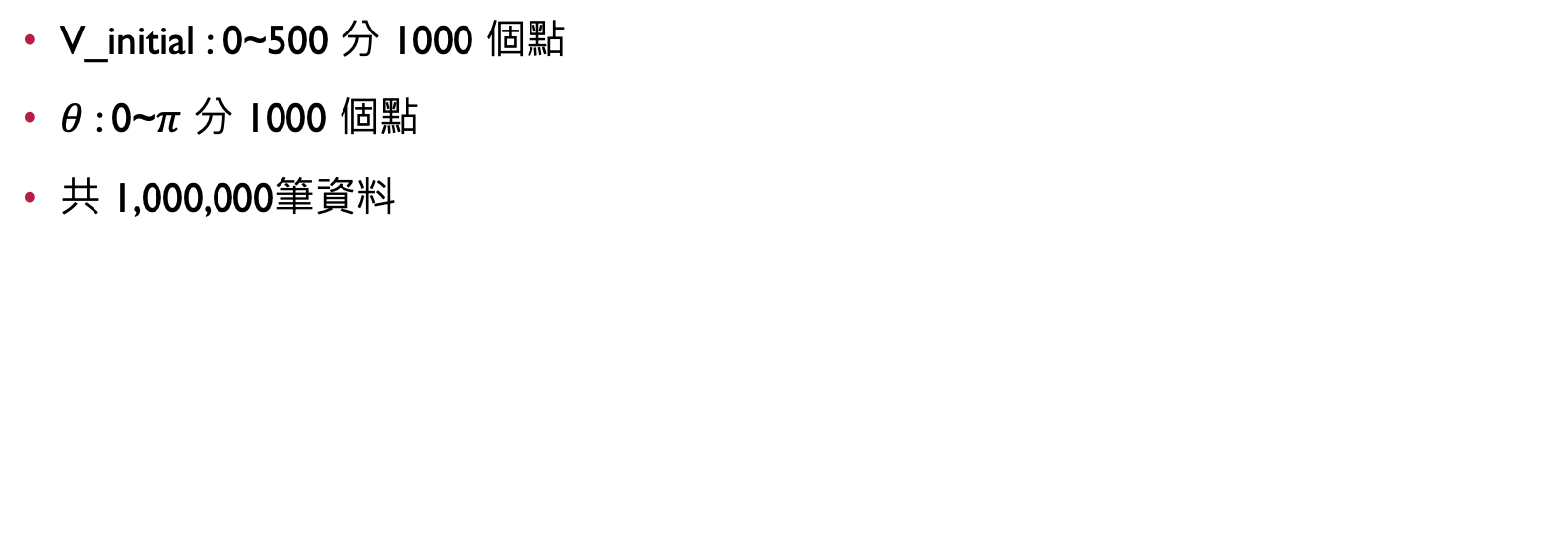
Data Preparation
V_initial : 0~500 分 1000 個點
$θ$ : 0~$π$ 分 1000 個點
共 1,000,000筆資料

Slide 5
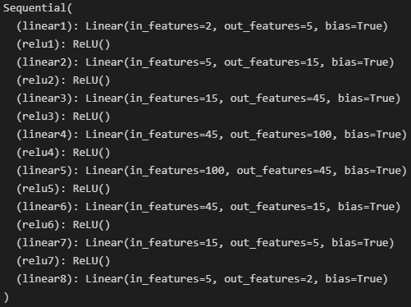
Model Construction 6 Hidden Layers As Example
Training : Testing | 8 : 2
Loss function | MSE
Optimizer | Adam
Hidden layers

Slide 6
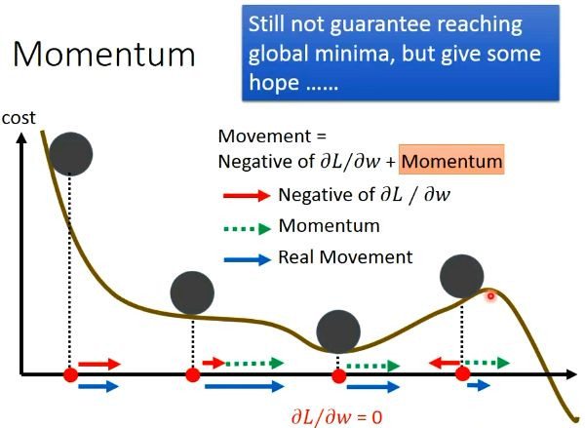
Optimizer Momentum
Momentum : 機器在學習的時候會帶著慣性，如果上一點的梯度比較大，則擁有比較大的慣性，在這一點的 learning rate 就會比較大一點，如果出現 local minimum 的問題則有機會跳出 local minimum，尋找真正的最小值。
圖片來源 : https://zhuanlan.zhihu.com/p/34240246

Slide 7
Optimizer ADAM = Momentum + Adaptive learning rate
AdaGrad : 在前期梯度較小的時候可以放大 learning rate 節省時間，後期梯度較大時又可以約束 learning rate。
ADAM : Momentum 和 AdaGrad 的結合，有 Momentum 的優點可以避免 local minimum，也有 AdaGrad 的優點可以在不需要注重細節的部份加大 learning rate ，避免不必要的時間浪費。

Slide 8
Variable
Analysis
Epoch
Hidden layer number
Neuron number
Height scatter
Range scatter
Loss
R2 score

Slide 9
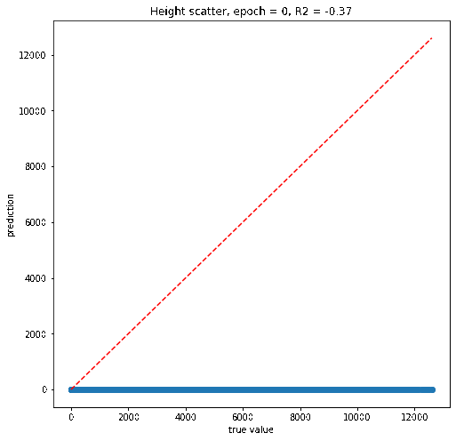
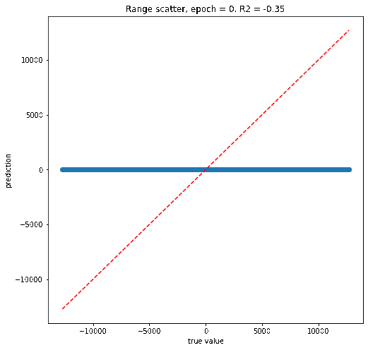
Variables 1. Epoch numbers

Slide 10
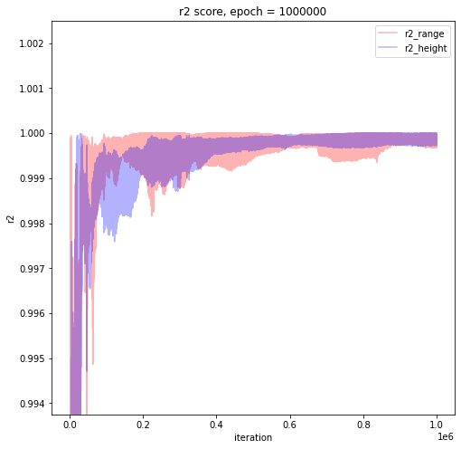
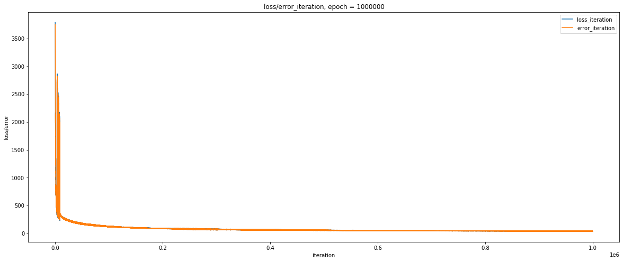
Variables 1. Epoch numbers
Epoch = 1M

Slide 11
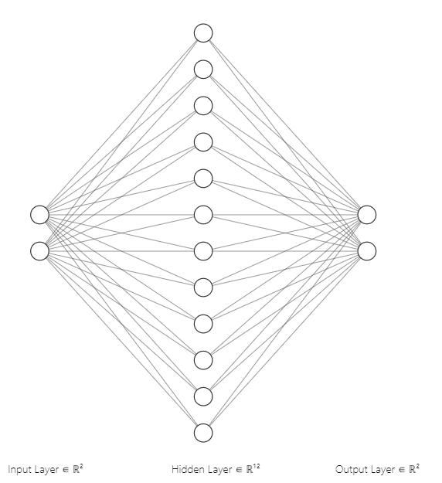
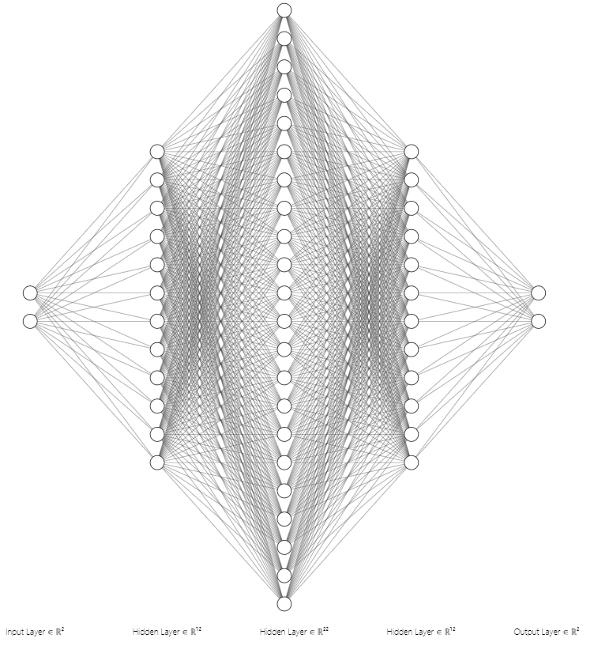
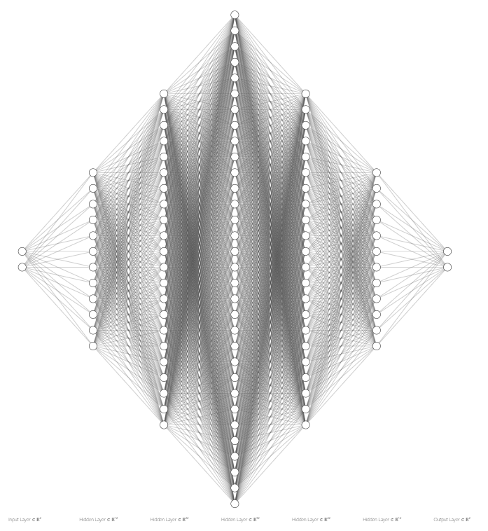
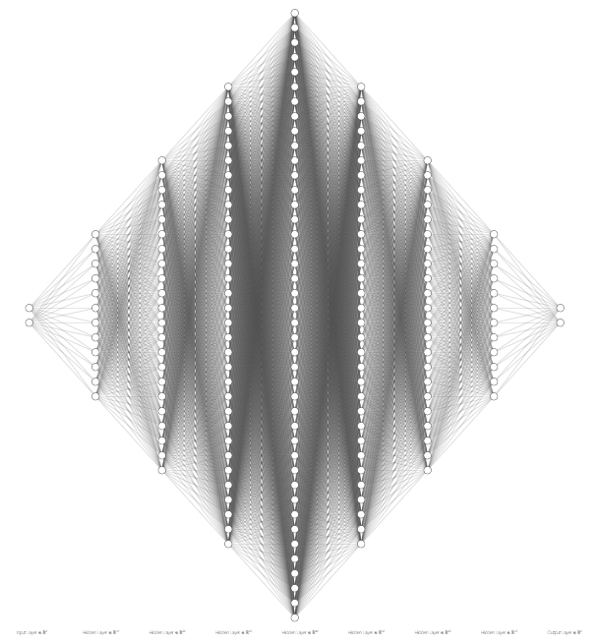
Variables 2. Layer numbers
Epoch = 20,000
1 hidden layer
3 hidden layers
5 hidden layers
7 hidden layers

Slide 12
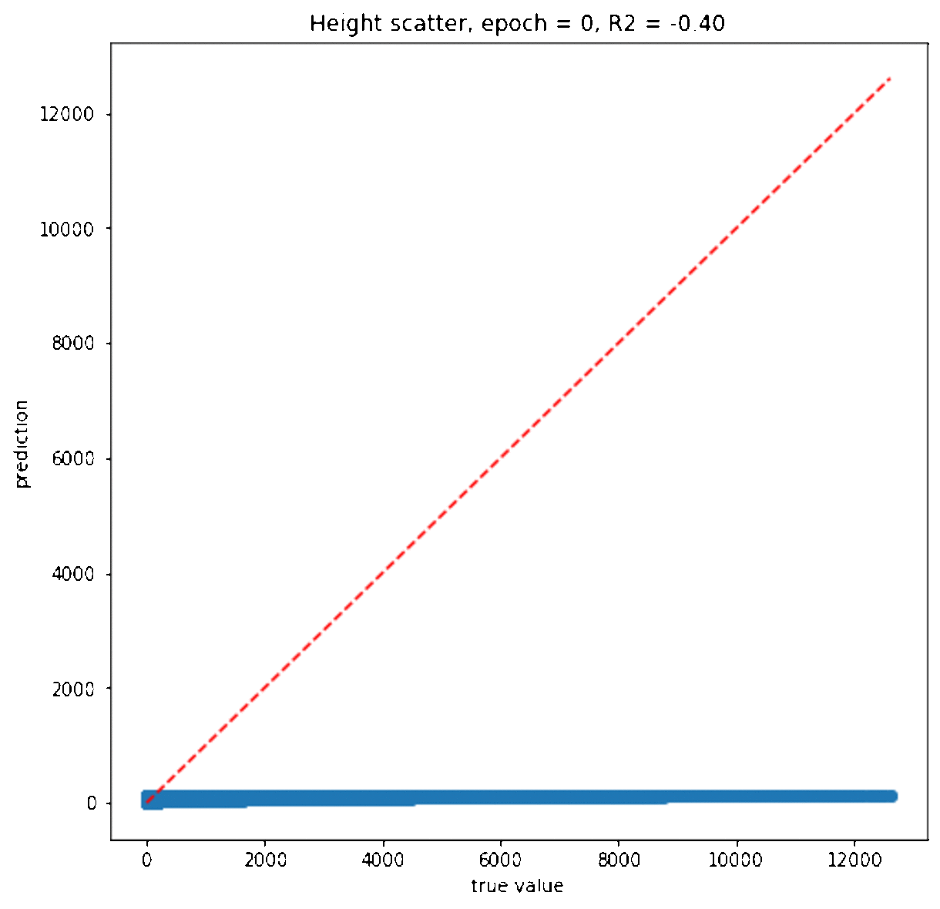



Variables 2. Layer numbers Height scatter
Epoch = 20,000
1 hidden layer
3 hidden layers
5 hidden layers
7 hidden layers

Slide 13

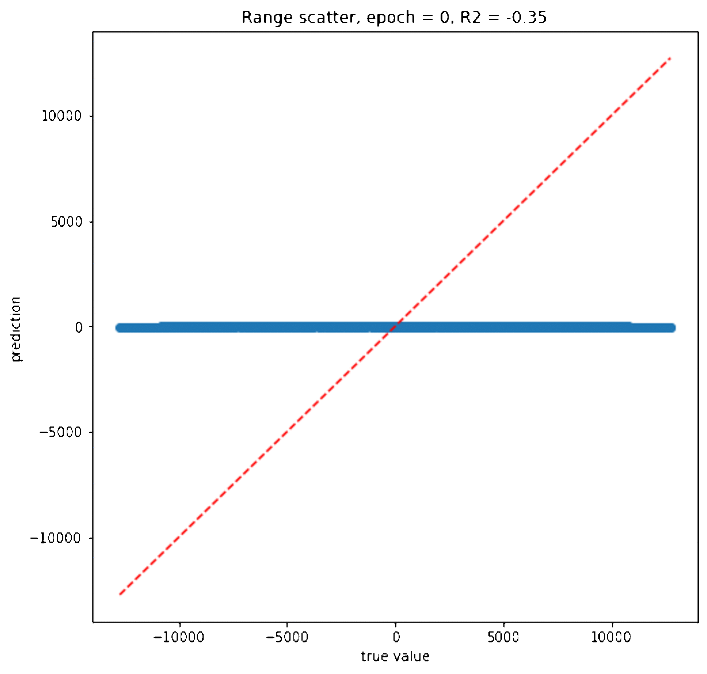
Variables 2. Layer numbers Range scatter
Epoch = 20,000
1 hidden layer
3 hidden layers
5 hidden layers
7 hidden layers

Slide 14
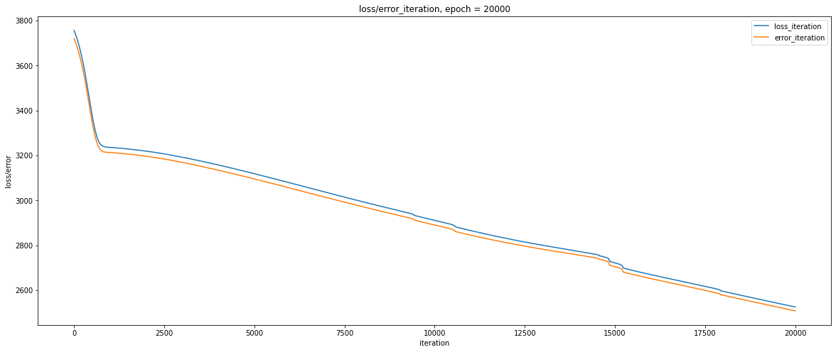
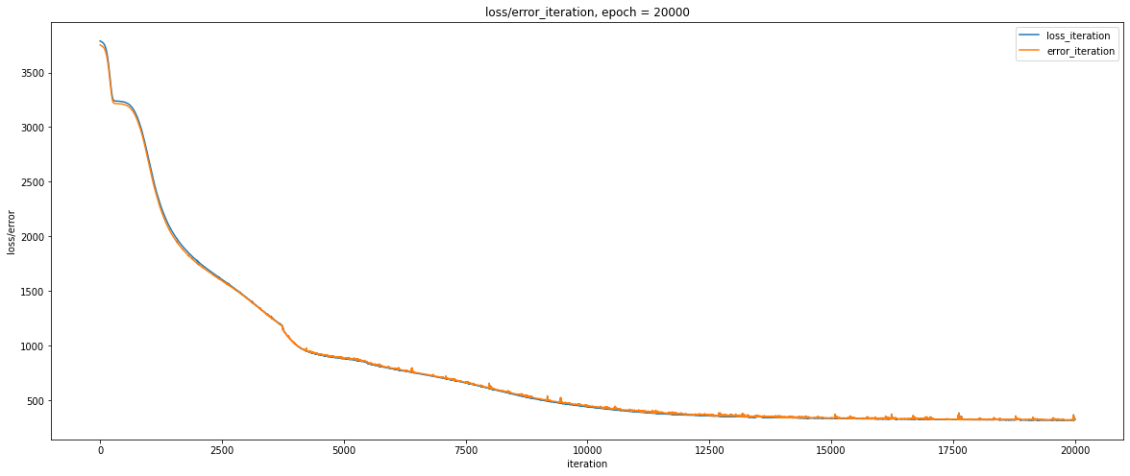
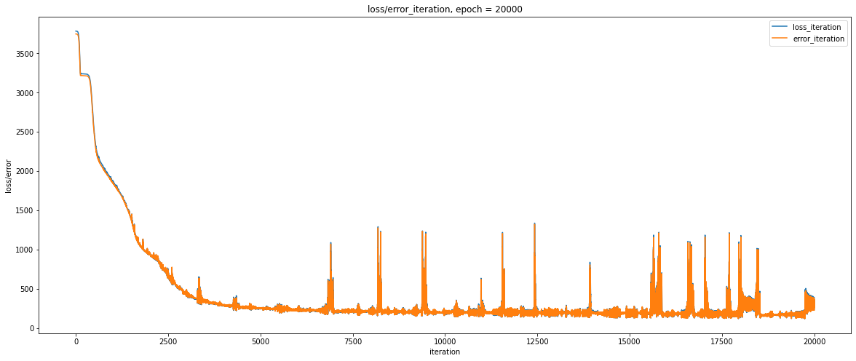
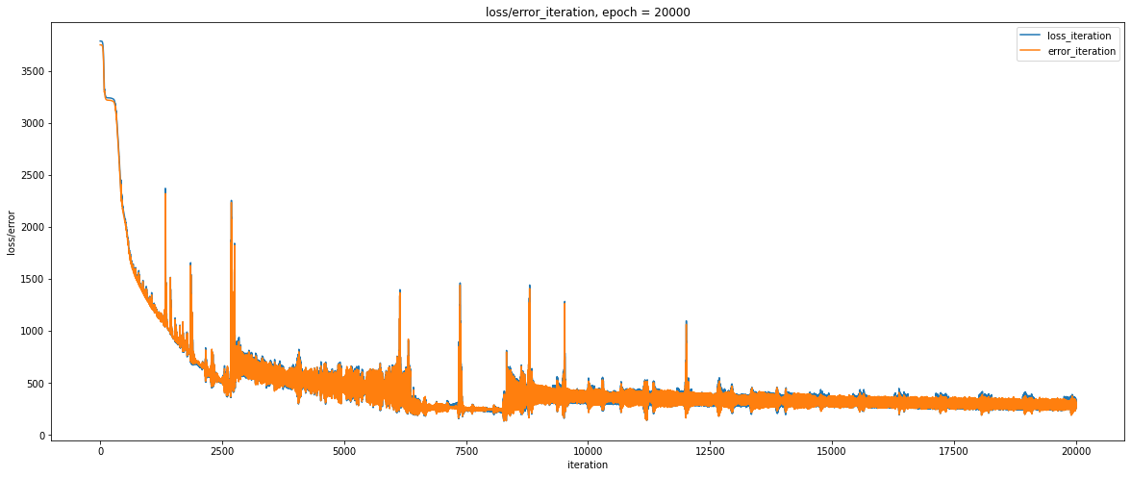
Variables 2. Layer numbers Loss
1 hidden layer
3 hidden layers
~3125@5000iter.
~875@5000iter.
5 hidden layers
7 hidden layers
noisy
~250@5000iter.
~500@5000iter.

Slide 15
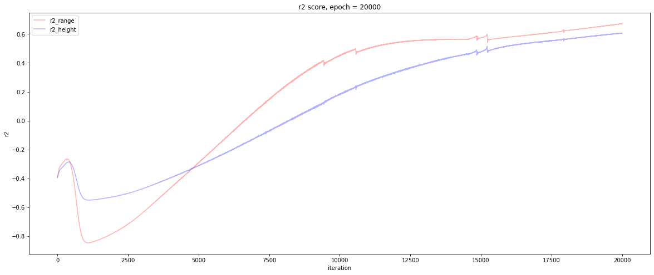
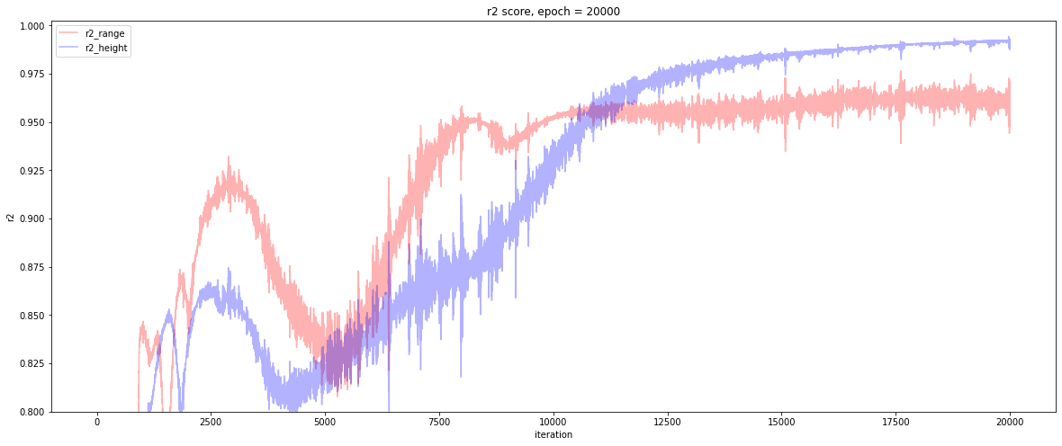
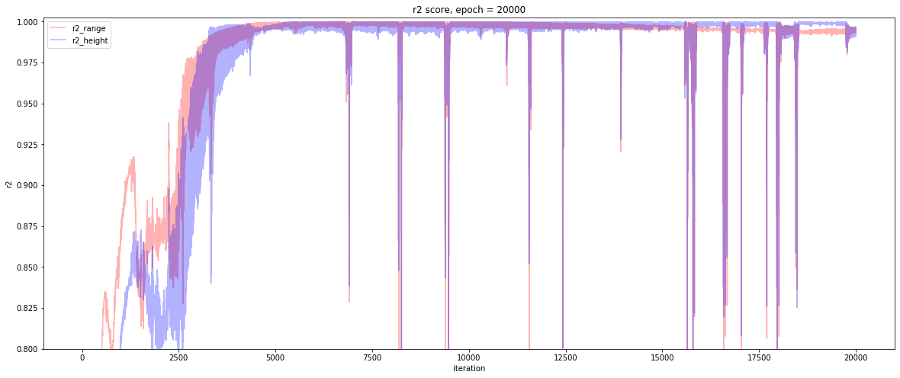
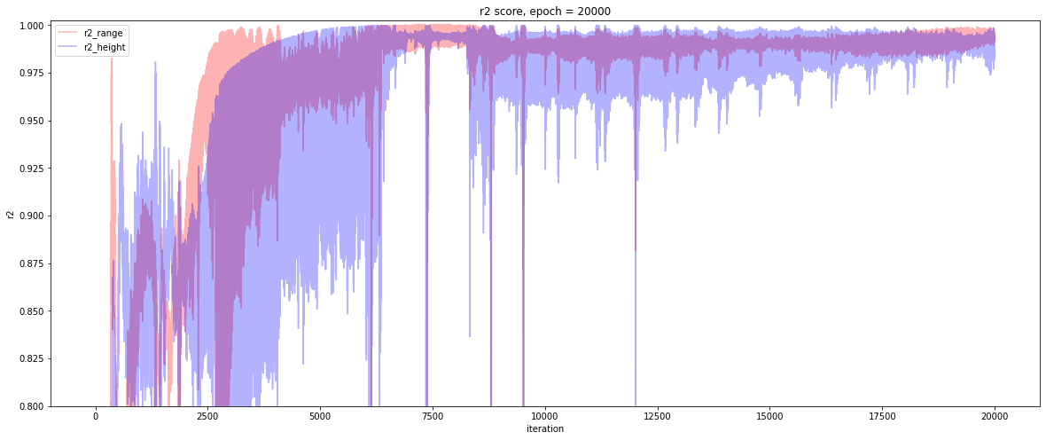
Variables 2. Layer numbers R2
1 hidden layer
3 hidden layers
noisy
5 hidden layers
7 hidden layers

Slide 16
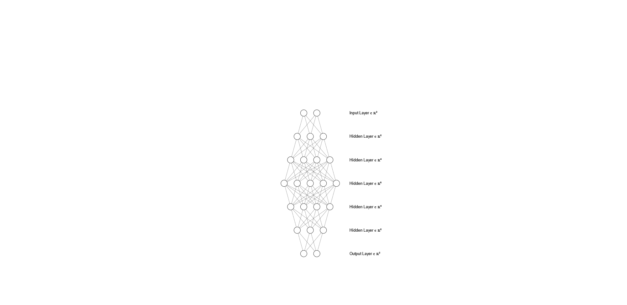
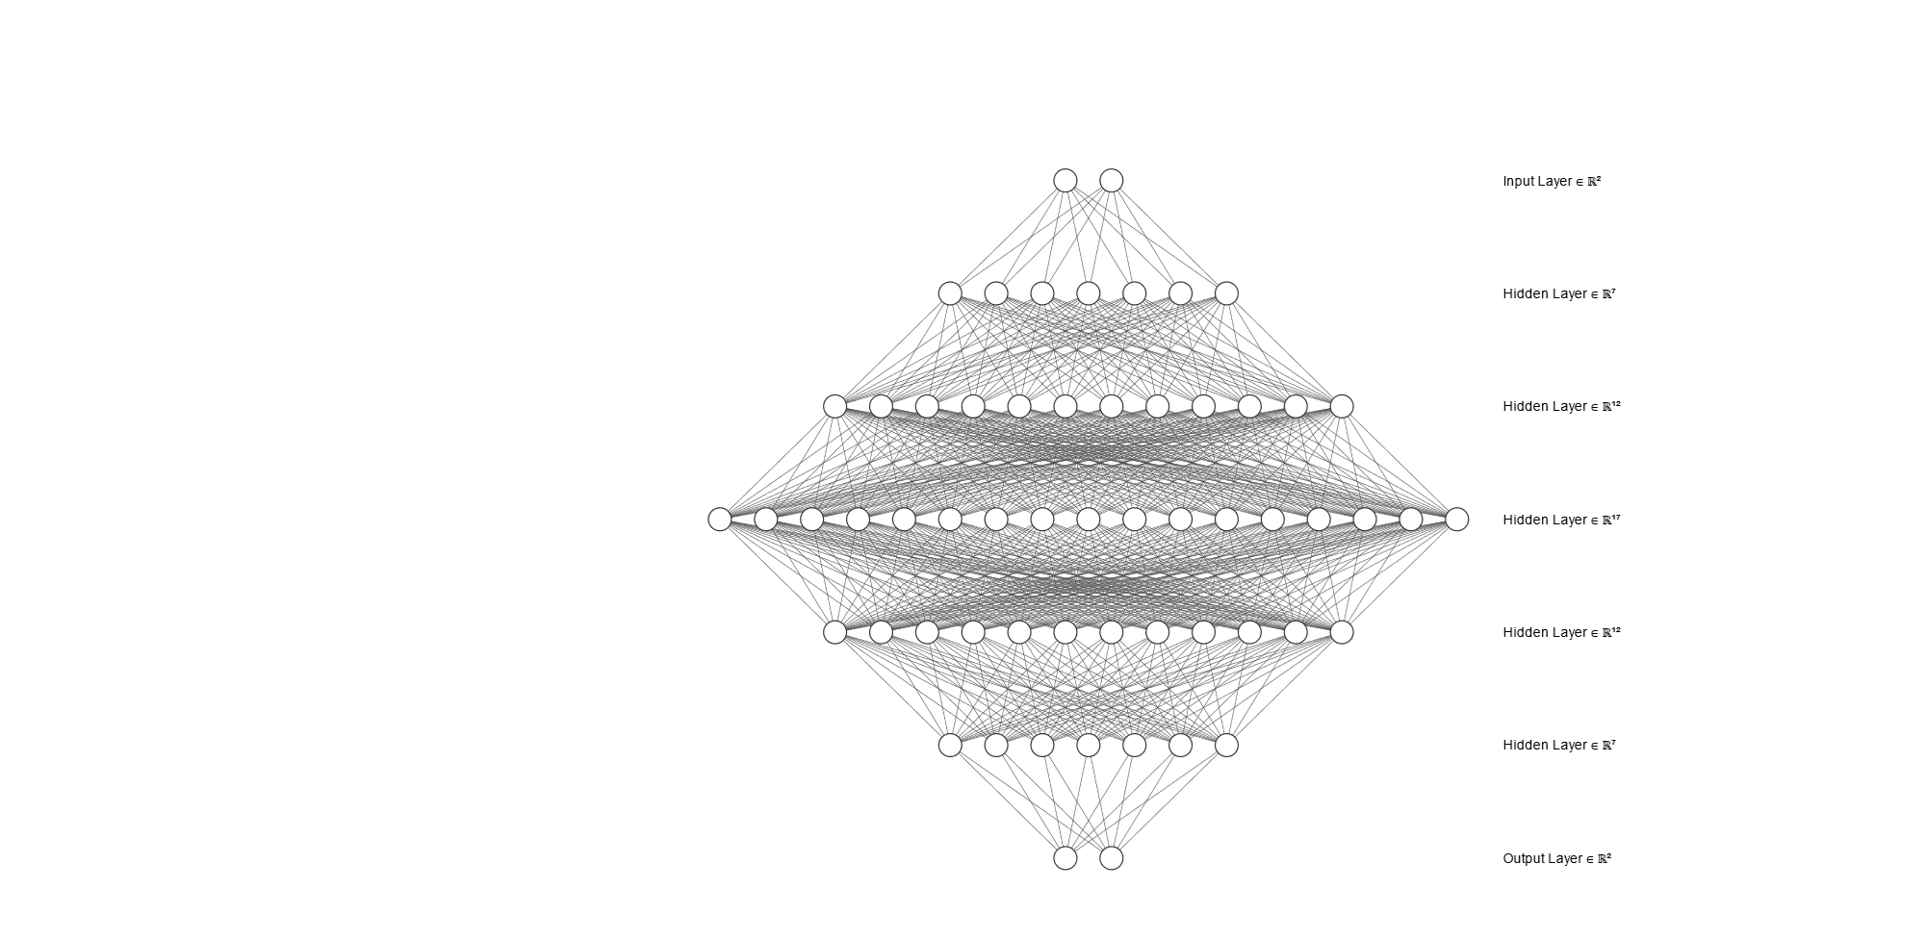
Variables 3. neuron numbers
Epoch = 20,000
+1 neuron/layer
+5 neuron/layer

Slide 17


Variables 3. neuron numbers Height scatter
+1 neuron/layer
+2 neuron/layer
+5 neuron/layer
+10 neuron/layer
+20 neuron/layer
+100 neuron/layer
收斂速度較慢

Slide 18

Variables 3. neuron numbers Range scatter
+1 neuron/layer
+2 neuron/layer
+5 neuron/layer
+10 neuron/layer
+20 neuron/layer
+100 neuron/layer

Slide 19
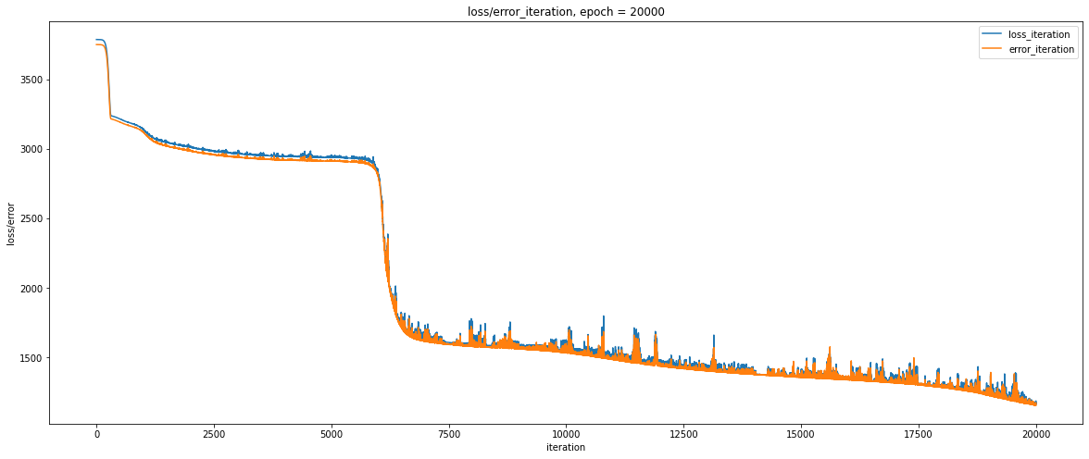
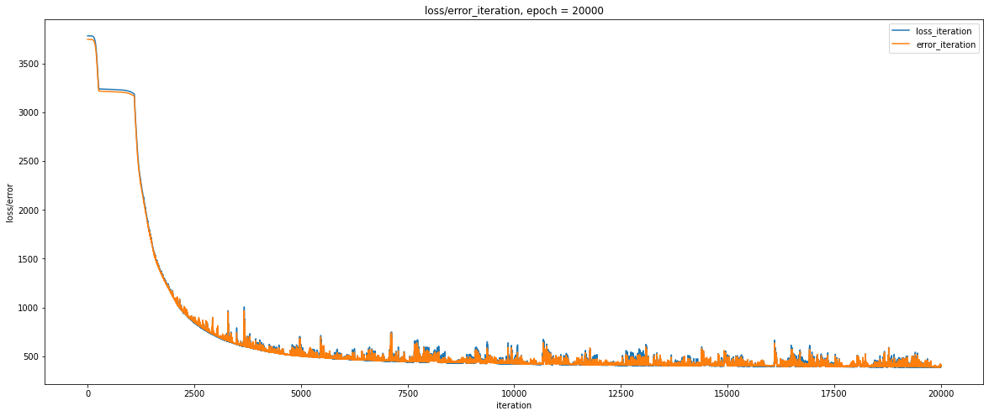
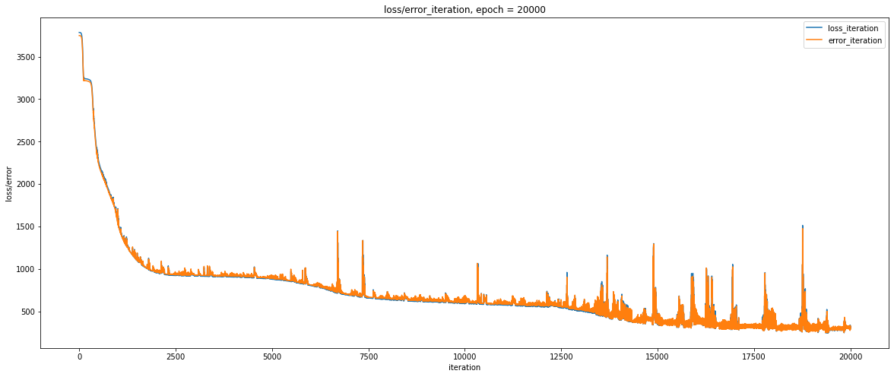
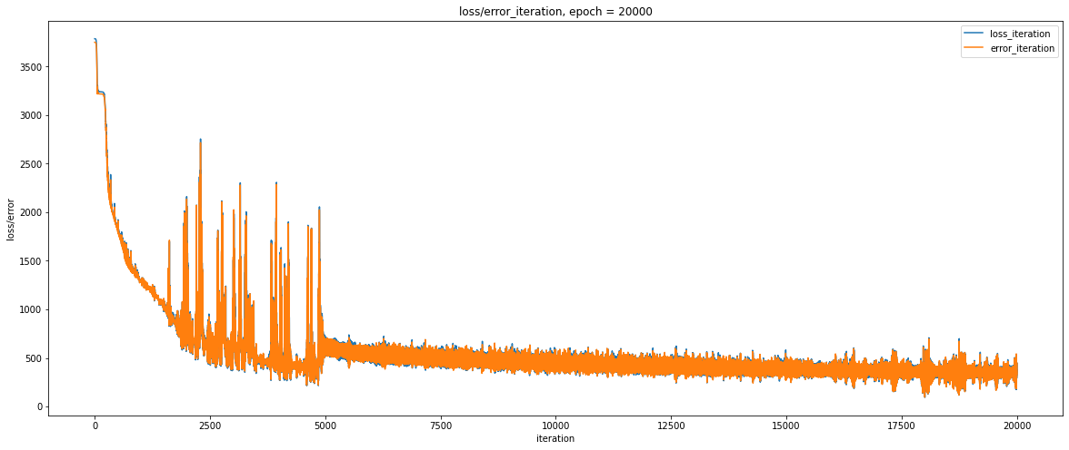
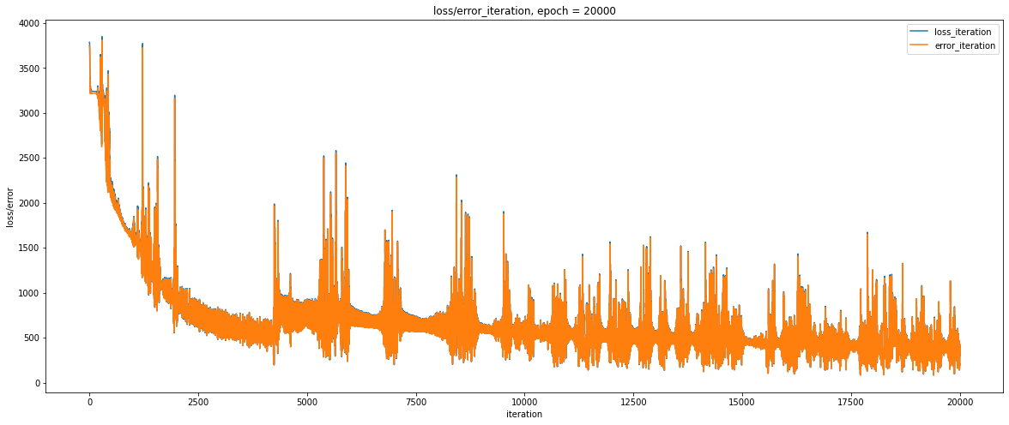
Variables 3. neuron numbers Loss
+1 neuron/layer
+2 neuron/layer
+5 neuron/layer
+10 neuron/layer
+20 neuron/layer
+100 neuron/layer

Slide 20
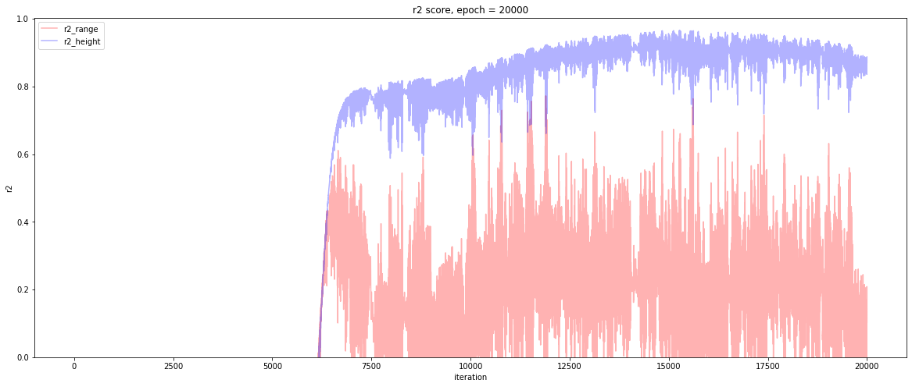
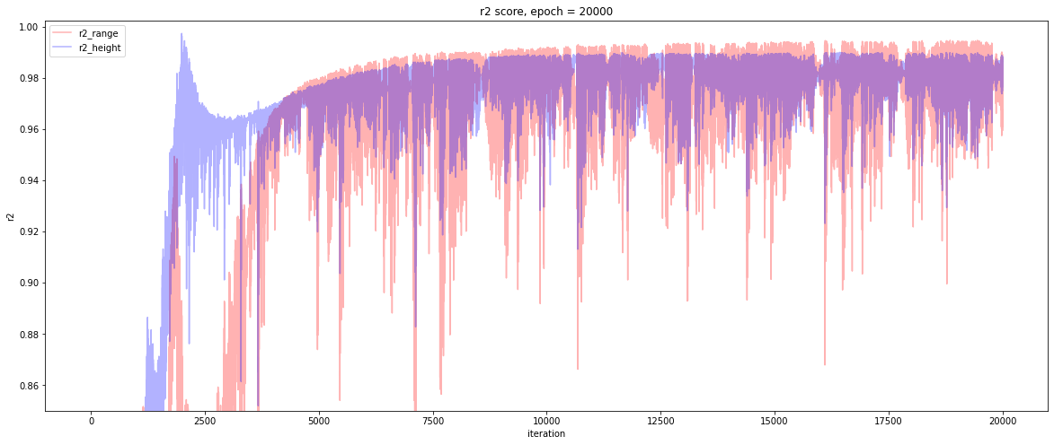
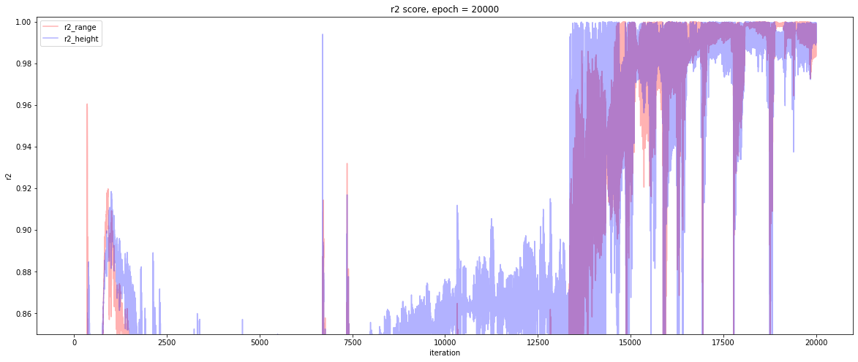
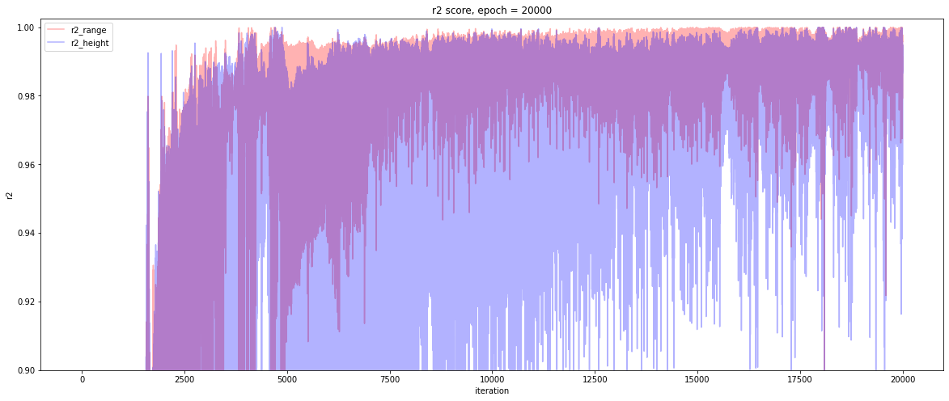
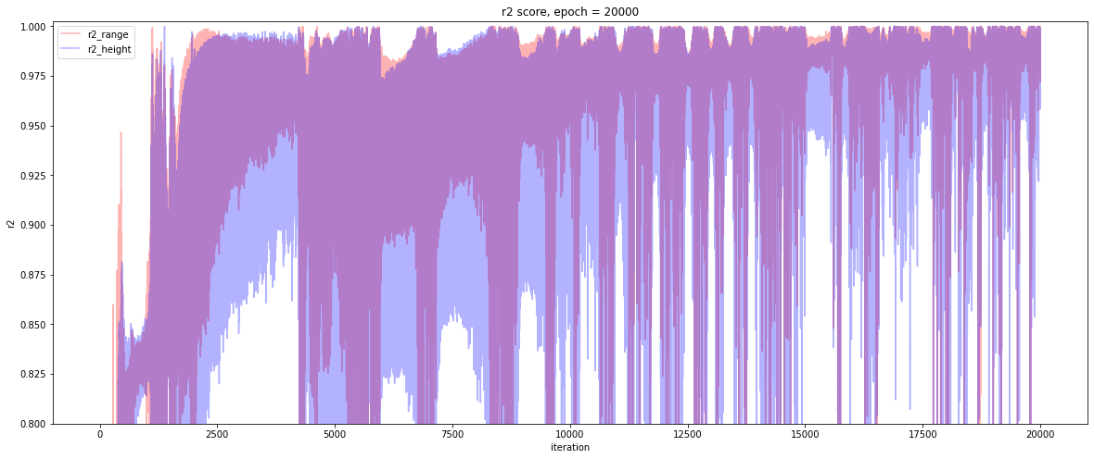
Variables 3. neuron numbers R2
+1 neuron/layer
+2 neuron/layer
+5 neuron/layer
+10 neuron/layer
+20 neuron/layer
+100 neuron/layer

Slide 21
Outside Of The Training Dataset
theta
v_init
*: noted that blue lines are out of the theta domain, in other words, unreasonable. (Throwing toward ground.)

Slide 22
期末報告計畫簡介
High power GaN device electrical property prediction

Slide 23

GaN 氮化鎵
Gallium nitride
Polarization => 2d electron gas
自發極化 (Spontaneous polarization, P_{SP})
壓電極化 (Piezoelectric polarization, P_{PE})
2DEG => normally on device
Si => normally off
AlGaN
GaN

Slide 24
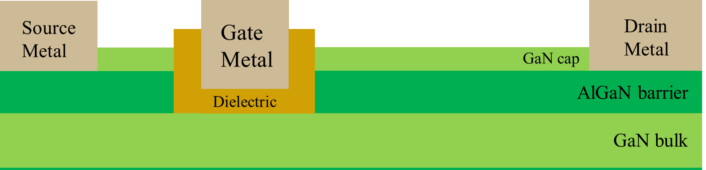
GaN HEMT Process Parameter
HEMT: high electron mobility transistor
AlGaN barrier thickness
Al percentage
Recess depth
Gate to drain length

Slide 25
Electrical Parameter IV
Ion: on current
Ioff: off current
Vth: threshold voltage
SS: subthreshold swing

Slide 26
Flow
Process parameters
TCAD
IV
4 parameters regularly used to analyze IV
With domain expertise
Random pick four point
(or based on some algorithm)
Without domain expertise
Prediction of process parameter
Prediction of process parameter
Compare the predictions
ref: H. Dhillon, K. Mehta, M. Xiao, B. Wang, Y. Zhang and H. Y. Wong, "TCAD-Augmented Machine Learning With and Without Domain Expertise," in IEEE Transactions on Electron Devices, vol. 68, no. 11, pp. 5498-5503, Nov. 2021, doi: 10.1109/TED.2021.3073378.

